Slide 1
Hands onWhen spectro-imaging
meets machine learning
David ROUSSEAU
LARIS, IRHS UMR INRA, 62 Avenue Notre Dame du Lac, 49000 Angers, France
david.rousseau@univ-angers.fr
1

Slide 2
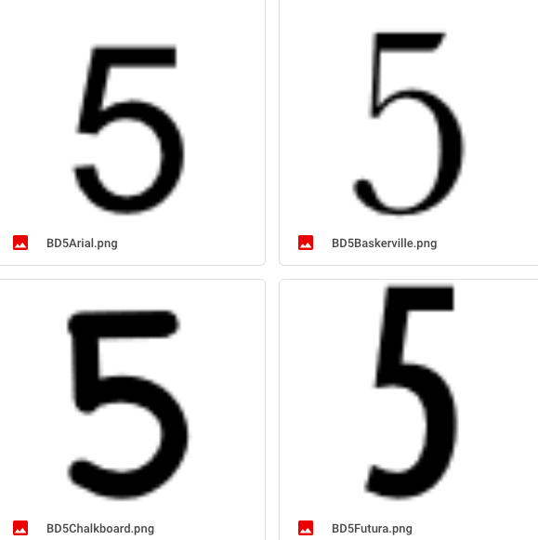
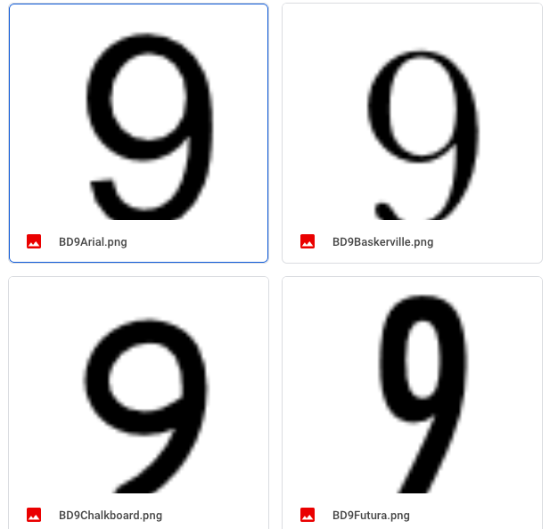
Mini-projet 1 classical machine learning
Goal : Feature design for a spectra imager applied to figure recognition

Slide 3
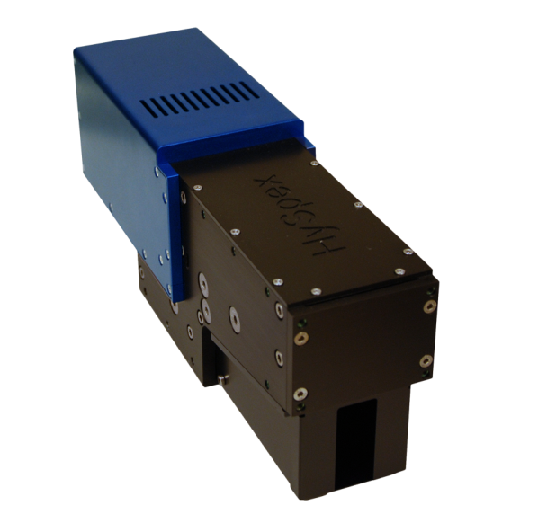
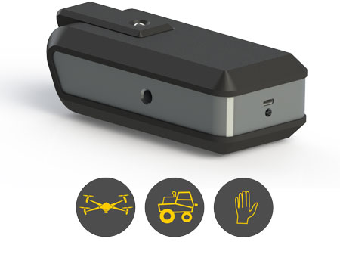
Sensor
10 cm
50 cm
100 keuros
10 keuros
Phd CIFRE Clément DOUARRE
sept. 2017-Sept. 2020

Slide 4
Principle of classical hyper spectral imaging

Slide 5
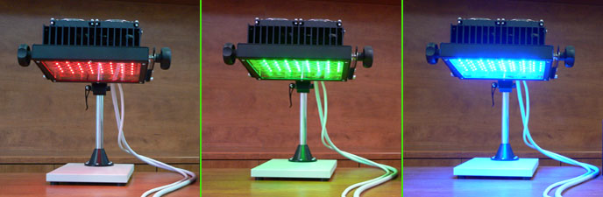
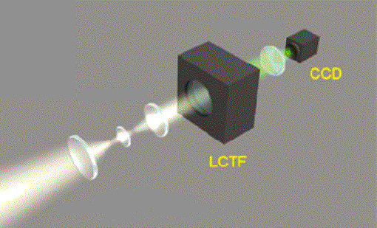
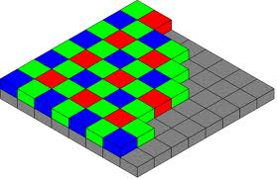
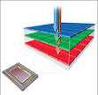
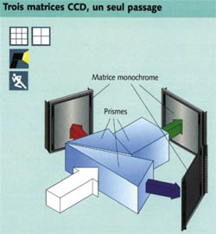
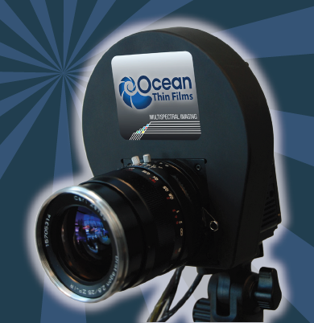
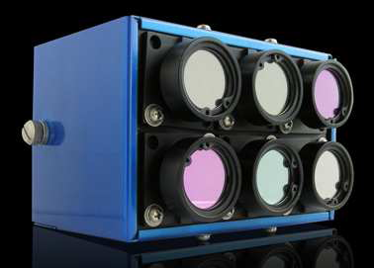
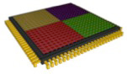
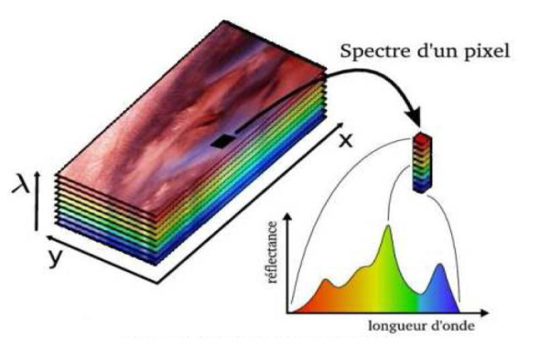
Example of applications in proxidétection
Type of sensors | Nb Channel | Filtrers | Imaging systems
Gray | 1 | Open choice (visible / NIR)
Color | 3 | Imposed (R V B) or on demand
Multispectral | 2 - 10 | Open choice (visible / NIR)
Hyperspectral | Tens to hundreds
Cost
L. Benoit, R. Benoit, E. Belin, R. Vadaine, D. Demilly, F. Chapeau-Blondeau, D. Rousseau; "On the value of the Kullback-Leibler divergence for cost-effective spectral imaging of plants by optimal selection of wavebands"; Machine Vision and Applications 27, 625-635 (2016)

Slide 6
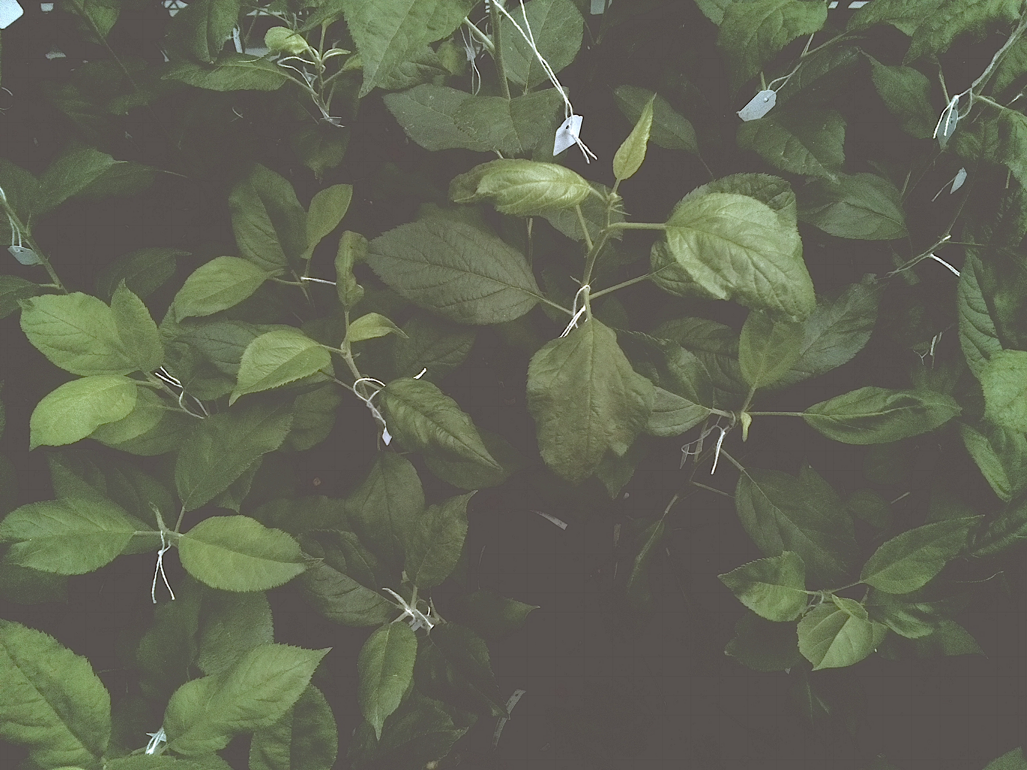
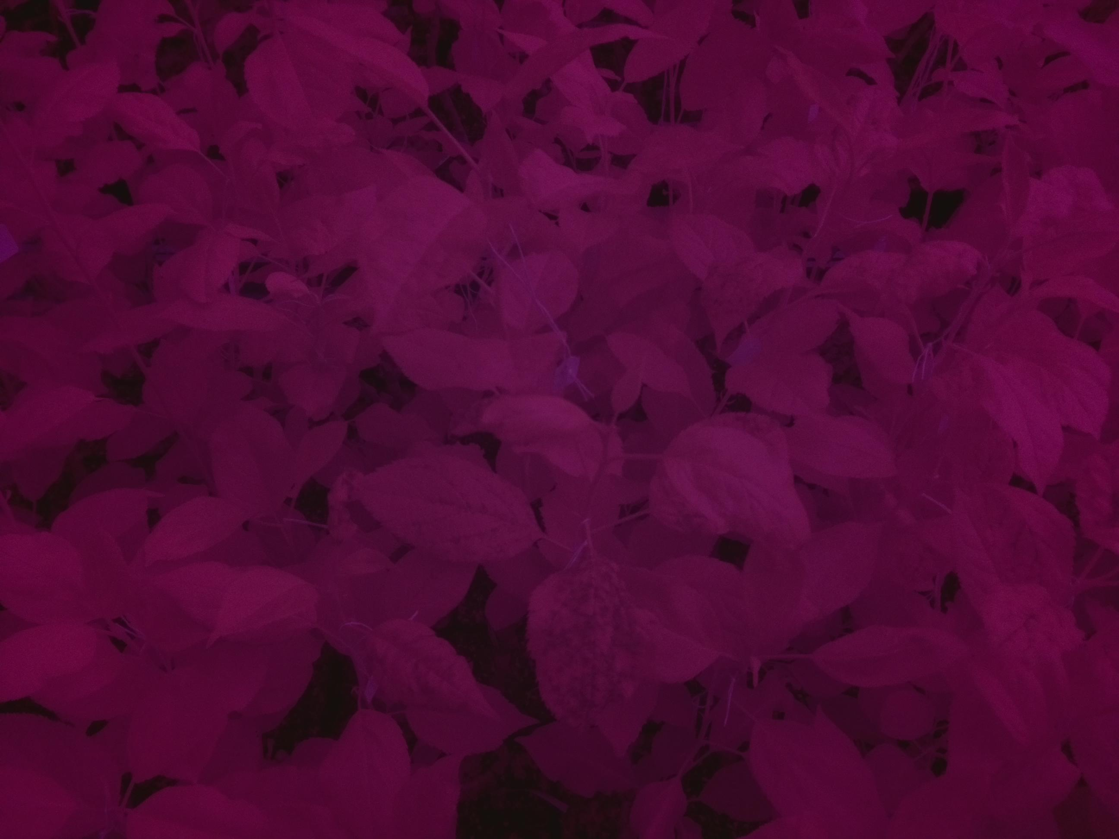
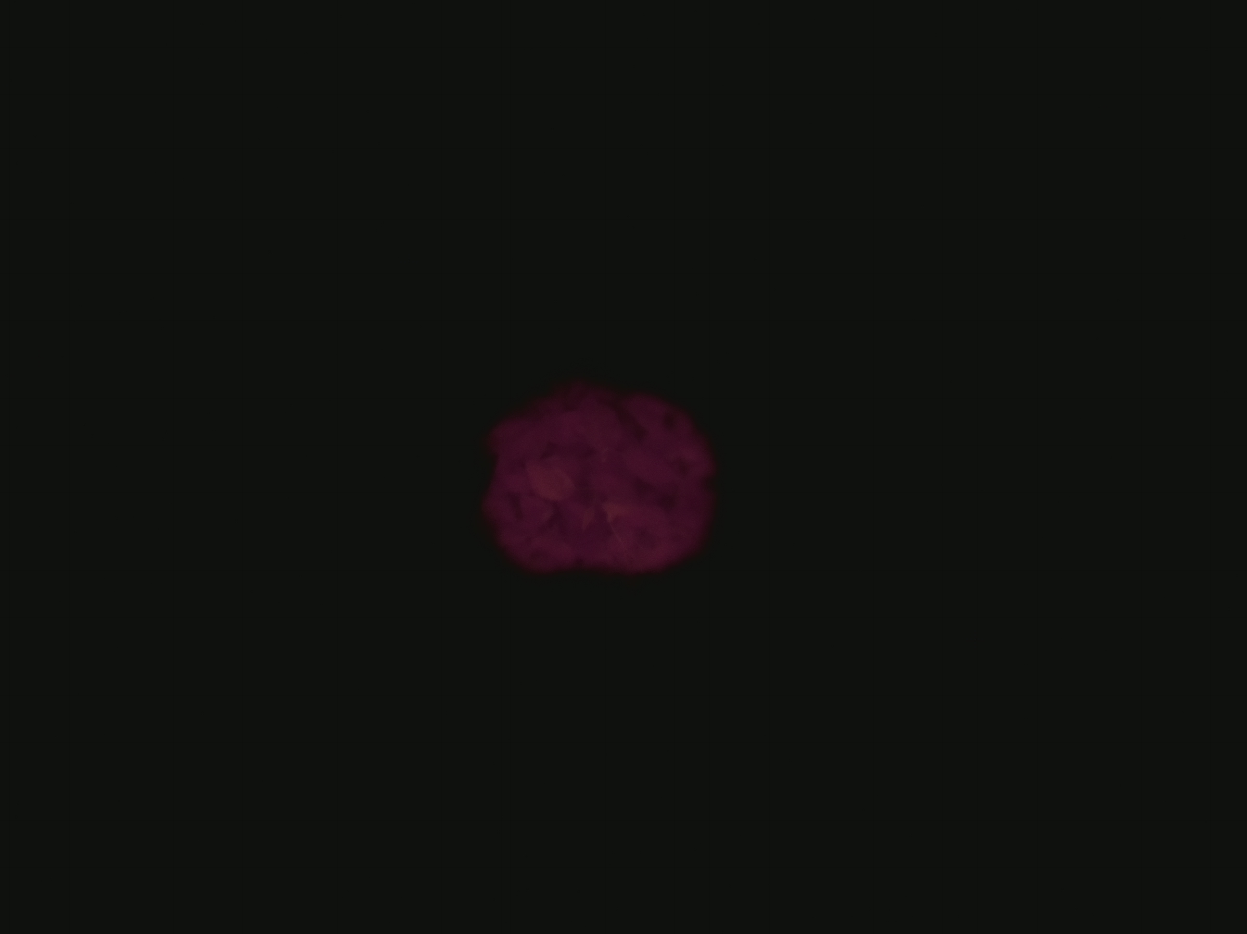
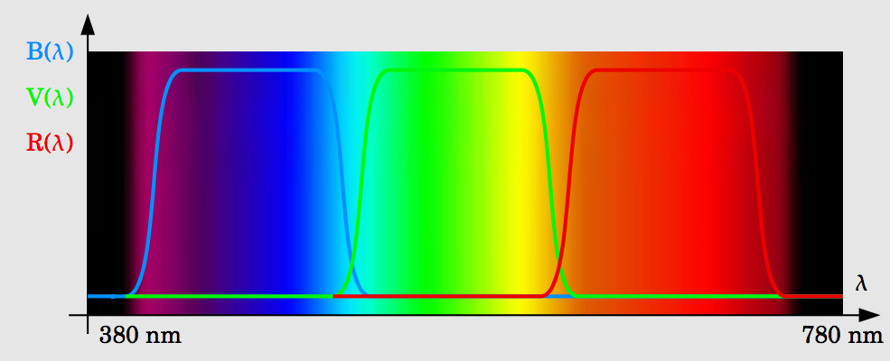
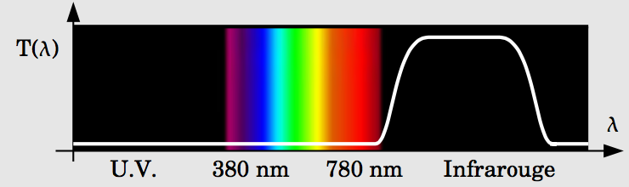
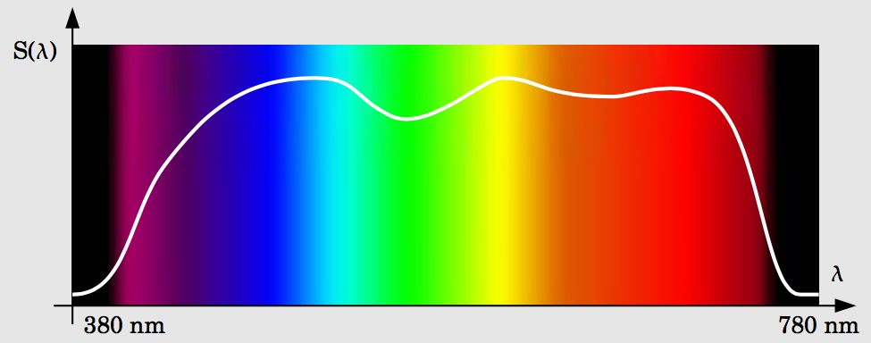
Principle of CB spectra imager
3 caméras in 1
Ordre zéro
Image RGB
Image IR
Cube hyperspectral non reconstruit

Slide 7
3 Steps
Download and observe the data
https://drive.google.com/drive/folders/1t5hLsHGL-bwN72xwiZYYCFjGplBiAE2F?usp=sharing
https://drive.google.com/drive/folders/13O9xn6LXj-ArdcKIWWLwOaueXYDjaEVS?usp=sharing
Design a feature space (handcrafted you)
Train the model
https://www.mathworks.com/products/statistics/apps.html

Slide 8
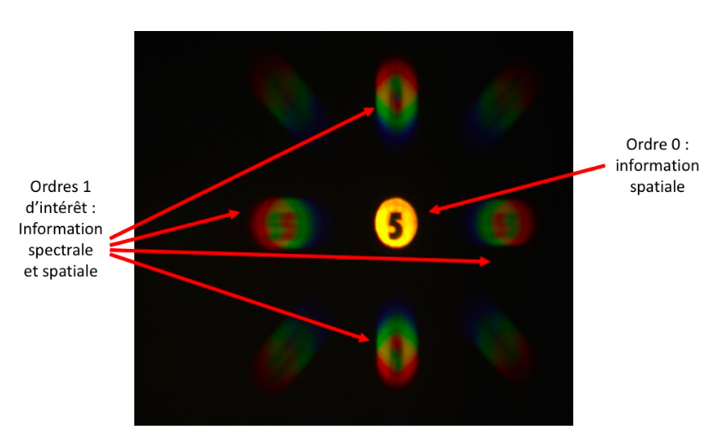
First step

Slide 9
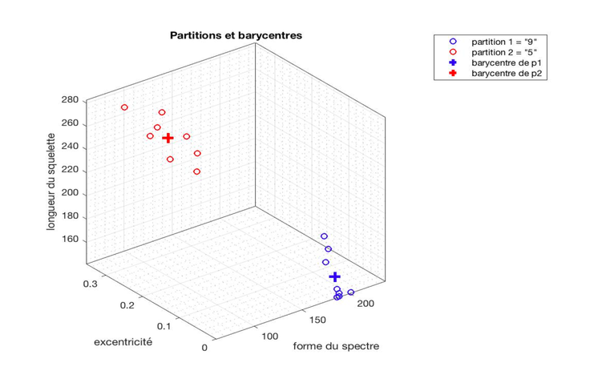
Step 2
Feature 3
Feature 2
Feature 1

Slide 10
Step 3 K-NN, SVM, Random Forest, …
Feature 3
Feature 2
Feature 1

